Slide 1
Design Guidelines And Tips Read Me And Delete Me
Best practices for using imagery
Use imagery (photos, graphics, icons or dimensional text) to reinforce the story you are telling.
These elements are used to grab reader’s attention, communicate an idea quickly, and improve visual interest.
Use a graphic as way to make a point, emphasize or reinforce an idea. Don’t cram in a graphic just to use it.
Photography
Photos inserted in this deck are provided as placeholder examples.
Change the photo imagery to better match your content
Ascendion brand imagery : https://ascendionhub.sharepoint.com/sites/CorporateMarketing-Hub/SitePages/Ascendion-Brand-Assets-Library.aspx
The Ascendion brand image library is updated periodically as new imagery becomes available

Slide 2

Ascendion delivers
^{AI}
Engineering
Engineering To The Power Of AI

Slide 3
An AI-Powered Software Engineering Disruptor
At Ascendion, our global presence and diverse teams are dedicated to delivering AI-driven solutions that make a real impact. By combining cutting-edge technology with human expertise, we transform businesses and elevate everyday experiences for clients around the world.
11,000+
Ascenders Globally
400
Enterprise Clients
4
AI Studios
36%
of the Fortune 500 are clients
40+
Offices Globally
13
Countries
10
Global Delivery Hubs
500+
Talent specialists
Notes:
Now if you notice something, year over year, with a new deck, out numbers are only going up.
An year ago, we were 7k+ ascenders globally with presence in 3 countries, but after our integration with GGM (Global Growth Market)m we are now 11k+ ascender strong, with our presence in over 12 countries worldwide.

Slide 4

Serving Clients Locally Across the Globe
Americas
Europe
Asia Pacific (APAC)
United States
Atlanta
Austin
Basking Ridge
Charlotte
Chicago
Dallas
Folsom
Glen Allen
Greenwood Village
Irvine
Jersey City
La Jolla
Minneapolis
Raleigh
Redmond
San Francisco
San Jose
Tampa
Mexico
Monterrey
Canada
Toronto
United Kingdom
London
Poland
Krakow
Warsaw
Ireland
Dublin
Romania
Bucharest
India
Bangalore
Chennai
Hyderabad
Pune (2)
Vadodara
Malaysia
Kuala Lumpur
Singapore
Singapore
Philippines
Cebu City
Makati City (2)
Australia
Sydney
New Zealand
Auckland
IRELAND
UNITED KINGDOM
INDIA
UNITED STATES
POLAND
MALAYSIA
MEXICO
ROMANIA
PHILIPPINES
SINGAPORE
AUSTRALIA
Notes:
Our global delivery model has now been taken to the next level, as you can see we are spread across continents, present in 12 countries with 40+ offices globally.

Slide 5
Global Hubs Are Essential “Anchors” For Delivery
INDIA
VADODARA
PUNE (2)
MEXICO
HYDERABAD
MONTERREY
CHENNAI
BANGALORE
PHILIPPINES
Cebu City
Makati City (2)
Notes:
Our Global Delivery Model makes sure that we serve the clients in a 24x7 model, assuring the timelines are met.
24x7 Service
Cost Optimization
Client Access
Talent Pool Availability

Slide 6
AI Studios Spark Co-Innovation With Clients
INDIA
UNITED STATES
HYDERABAD
AUSTIN
CHENNAI
PHILIPPINES
MAKATI CITY
Notes:
What is the difference b/w a Delivery hub and an AI studio
When are where are we expecting our new AI studio

Slide 7



Solving Global Engineering Problems
Software engineering powered by AI
Applied AI
GCC^{AI}
Data^{AI}
Experience^{AI}
Ascendion AAVA™
Industry recognized Engineering AI platform
11,000+ Ascenders
Capabilities
Platform Engineering^{AI}
Product Engineering^{AI}
Quality Engineering^{AI}
Healthcare &
Life Sciences
Banking &
Financial Services
Communications,
Media, &
Entertainment
40+ Locations 10 Global delivery hubs
400 Enterprise clients
Industries
High-Tech
Retail & Consumer Goods
Travel & Hospitality
Global Delivery Hubs
Our Booster Rockets
Ascendion AAVA™ uses AI to improve engineering quality, transparency, velocity, and savings
Our unique digital talent orchestration model significantly reduces time to talent value
Innovative commercial models with AI Arbitrage priced in (to free up technical debt and fuel innovation)
Pune (2)
Monterrey, MX
Manila, PH
Cebu City
Makati (2)
Bangalore
Baroda
Chennai
Hyderabad

Slide 8










Software Engineering At The Intersection Of Technology And Talent Our Core Services
Platform Engineering^{AI}
Digital Talent Orchestration
Legacy applications transformed into modern software
TALENT
TECHNOLOGY
Our AI powered intelligent talent cloud platform gets the right team deployed at digital velocity
METAL –Talent Platform
Product Engineering^{AI}
New software products for today’s consumers and workers
GCC^{AI}
Human Capital Transformation
AVA+ – Intelligent Engineering Platform
AI-native GCCs powering global digital transformation.
RECODE
CIO-aligned management of change advisory for digital innovation
Quality^{AI}
Reliable systems for business impact with high productivity
JUMP
Access a digital-ready workforce through our customizable STEM program
Data^{AI}
Modern data foundations with embedded intelligence to maximize value and ROI
REWIRE
Customizable programs from 45,000+ leading digital practitioner coaches to reskill digital teams
Notes:
Applied AI Data^{AI} Experience^{AI} Platform Engineering^{AI} Product Engineering^{AI} Quality Engineering^{AI}

Slide 9


Leaders Are Wrestling With Three Challenges
The Crisis of Trust
Ascendion AAVA™ provides real time transparency across the software lifecycle, ensuring visibility, IP protection, and modern delivery solutions
The Crisis of Speed
AAVA™ accelerates software delivery by streamlining workflows with intelligent agents, maintaining top-quality standards
The Crisis of Capital
AI Arbitrage reduces technical debt, freeing capital for innovation, with shared-risk models to ensure mutual success

Slide 10
Leading With AAVA™ Platform For Engineering^{AI}
AAVA™ studios prioritize an AI-first approach expediting the pace of transformation and release cycles
ENGINEERING
OPERATIONS
Plan & Discovery
Architecture & Design
Development
Testing
Release and Run
Automation
AAVA™ Product Studio
AAVA™ Design Studio
AAVA™ Architecture Studio
AAVA™ Digital Ascender
AAVA™ Quality Engineering Studio
AAVA™ Data Modernization Studio
AAVA™ FinOps Studio
AAVA™ AI Powered Operations
AAVA™ ONEVIEW
Notes:
A.AAVA™ enablers/studios provides a wide range of diverse capabilities; providing Gen AI acceleration in all the phases of SDLC. And from the dawn of AAVA™, we have come a very long way in adapting and using the studios.

Slide 11



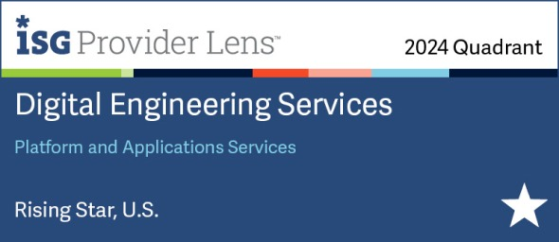
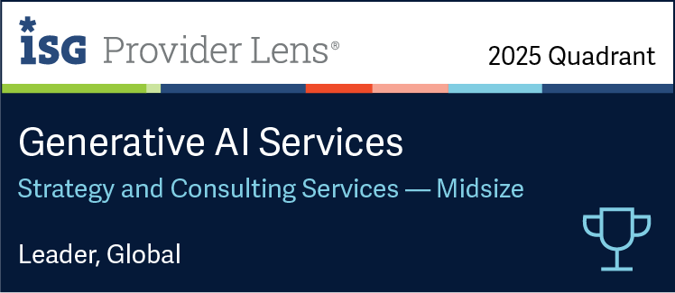
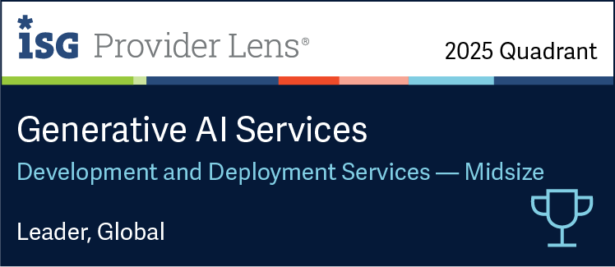
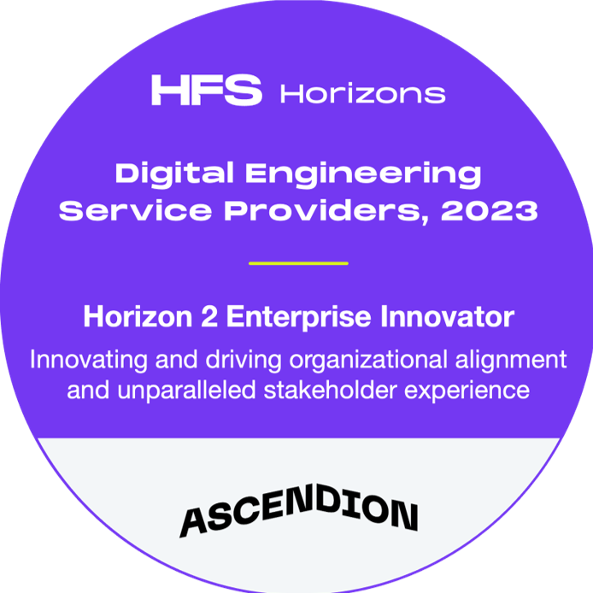
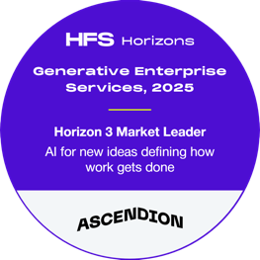



Industry Analysts Are Validating Our Progress
Ascendion AAVA™ platform featured in Gartner Generative AI in Outsourced Software Development
Received an Honorable mention in the Magic Quadrant for Custom Software Development Services
Featured by Gartner for pioneering “AI Arbitrage” — a new benchmark for pricing and value creation in AI-driven services
Ascendion Confidential
11
Notes:
It is not only about implementation, but we believe that whatever we do, we create impact which lasts long. Ascendion has been recognized by ISG as the Gen AI services leader.

Slide 12


Ascendion Takes Gold as 2025 AI Service Provider of the Year!
Globee® Awards 2025 Gold Winner
Driving real business impact with AI innovation
Transforming enterprises through AAVA™ platform
Revolutionizing software with Agentic AI

Slide 13
Leaders Are Wrestling With Three Challenges
 | Leader are facing … | … The Ascendion “Antidote”
Crisis of trust | Lack of transparency Lack of proven capability | Our genAI platforms, methods, and culture Modern delivery capability (e.g., Circles, IP, cases, market validation)
Crisis of speed | Lack of velocity in the engineering process Lack talent velocity | For Engineering: AAVA™ (with agents enhancing specific workflows), methods and processes For Talent: Velocity and quality from Metal, data, processes, workforce development
Crisis of Capital | Tech debt “eating” innovation investment Lack of options to reduce and share innovation risk | AI Arbitrage reduces technical debt and frees up capital for innovation and growth! Flexible shared risk commercial options with "skin in the game" models For Talent enhancement of more junior engineers
Notes:
PodAI → fast digital talent, incremental impact, shorter duration)
ProgramAI → more transformational: Ideation, through to value for productivity aligned to processes and business outcomes)
PlatformAI →clients bring us in as an accelerator; PaaS software with an "expert services" layer (We did this with a large manufacturer. Exploring with a bank).

Slide 14
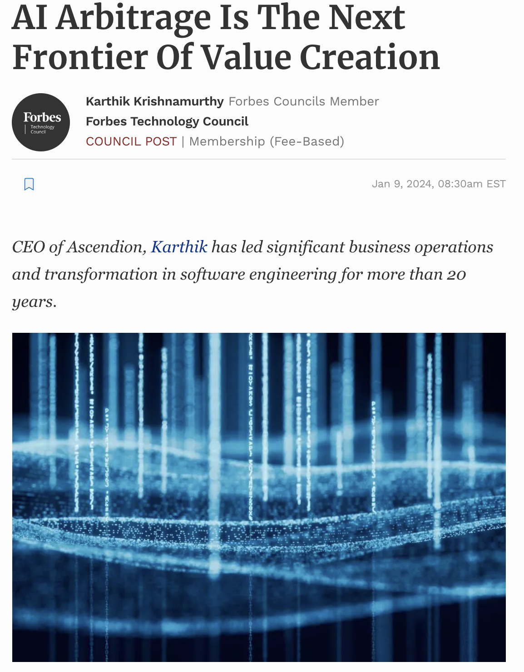
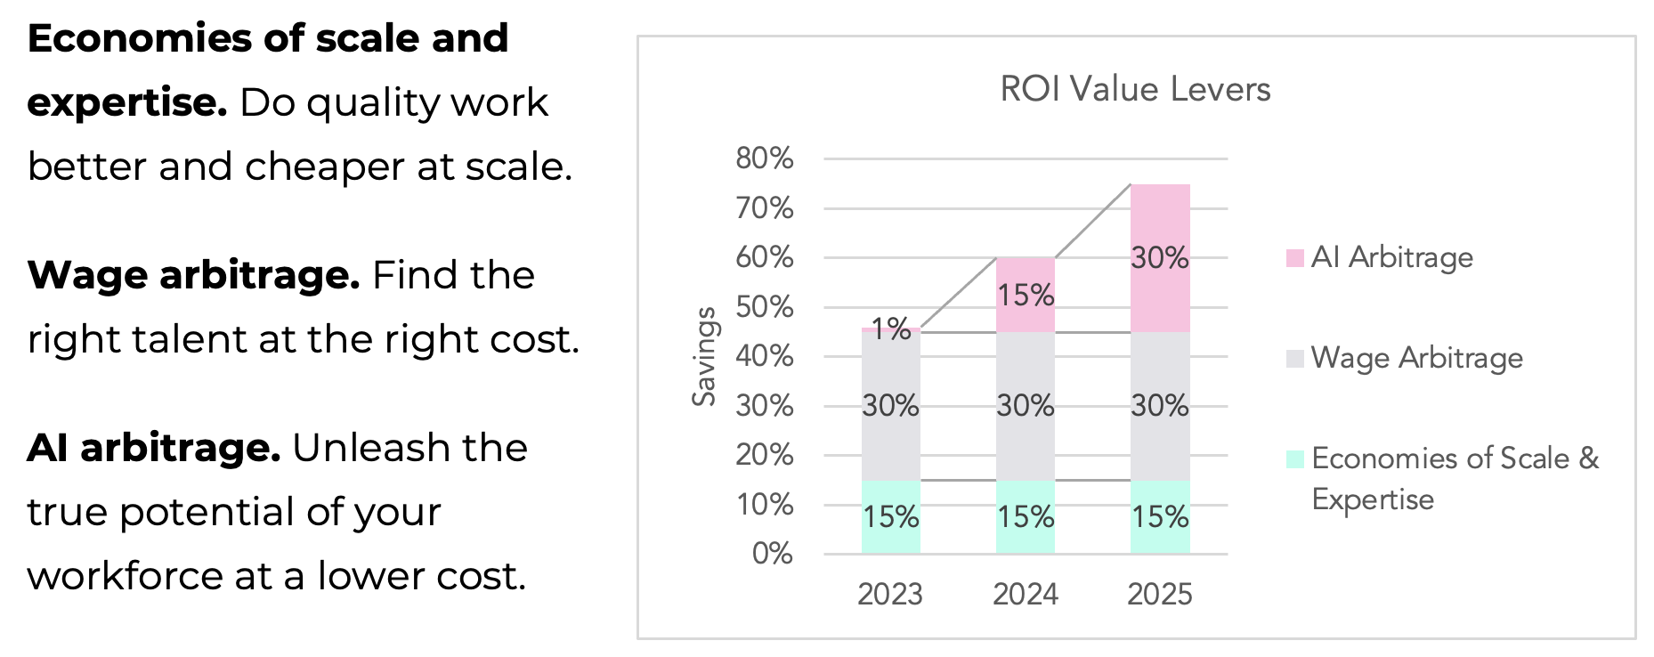
AI Arbitrage Will Unlock Capital For Innovation GenAI Is “Eating” IT Services
We are moving WORK to SOFTWARE – AAVA™
The new name of the game is productivity via ENHANCED humans
We are now offering TWO commercial models
Heritage
AAVA™ based
https://www.forbes.com/sites/forbestechcouncil/2024/01/09/ai-arbitrage-is-the-next-frontier-of-value-creation/

Slide 15

Engineering^{AI} Is Shifting The Services Demand Curve And Ascendion Can Be Ahead Of The Wave
Gen AI is giving us our Y2K imperative
Without Engineering^{AI}, these imperatives would be too expensive and risky
Legacy modernization
Now it’s FEASIBLE with AI Arbitrage
Application management and support
Quality Engineering
Engineering^{AI} we can do it differently
Data Modernization
Unlocking the business value of modern data faster, while reducing legacy costs
This is our revolution

Slide 16

Software Engineering to the POWER of AI
One of the largest global pure-play software engineering companies
Allies to >400 of the best brands in the world, serving more than a third of the Fortune 500
+11,000+ Ascenders // 40 offices in globally // 10 global delivery hubs // 4 AI Studios
New commercial models with AI Arbitrage priced in (to free up technical debt and fuel innovation)
Our two booster rockets:
Ascendion AAVA™ uses AI to improve engineering quality, transparency, and velocity
Our unique digital talent model significantly reduces time to talent value

Slide 17

… AI-powered solutions don’t work “out of the box”
Nearly every company needs help to go the Last Mile for value
That’s where we come in!

Slide 18
A New Kind Of Services Company For A New Era Of Business And Technology
Delivery powered by Gen AI platforms
Big enough for the Enterprise;
Small enough to serve
AAVA™, Metal, and more deliver higher levels of transparency, productivity, quality, and velocity.
11,000+ Ascenders // 40
Global Offices // 10 Global
Delivery Hubs // 4 AI Studios
Focus
Ascendion
A new kind of company or a new era of business and technology
A market leader in applied AI and Software
We. Do. Software. The largest pure-
play software services company.
A market leader in Gen Al. A digital
innovator in Software Engineering.
Commercial Agility
Delivering the BROADEST talent pool
Commercials aligned to today (not
the 1980s). We can start with one,
ten, or 1,000 and scale. Al
Arbitrage can be built in.
Talent Specialists accessing digital
experts to drive team quality and
innovation velocity. digital talent
boostr rocket!
Notes:
Ascendion is a new kind of company for a new era of business and technology
POWERED by Gen AI-powered platforms.
AVA+, Metal, and AIDA deliver higher levels of transparency, productivity, quality, and velocity in engineering and talent orchestration
Digital Talent Orchestration.
Hundreds of Talent Specialists accessing millions of immediately available digital experts to drive team quality and innovation velocity
Focus.
The largest pure-play company focusing on all aspects of bringing software to life
Commercial Agility.
Commercials and how we work are aligned to tomorrow (not the 1980s). We can start with one, ten, or 1,000 and scale
Enterprise Grade with personalized service.
6,000+ Ascenders // 16 offices in North America // 6 global delivery hubs (India and Mexico)
A market leader in applied AI.

Slide 19
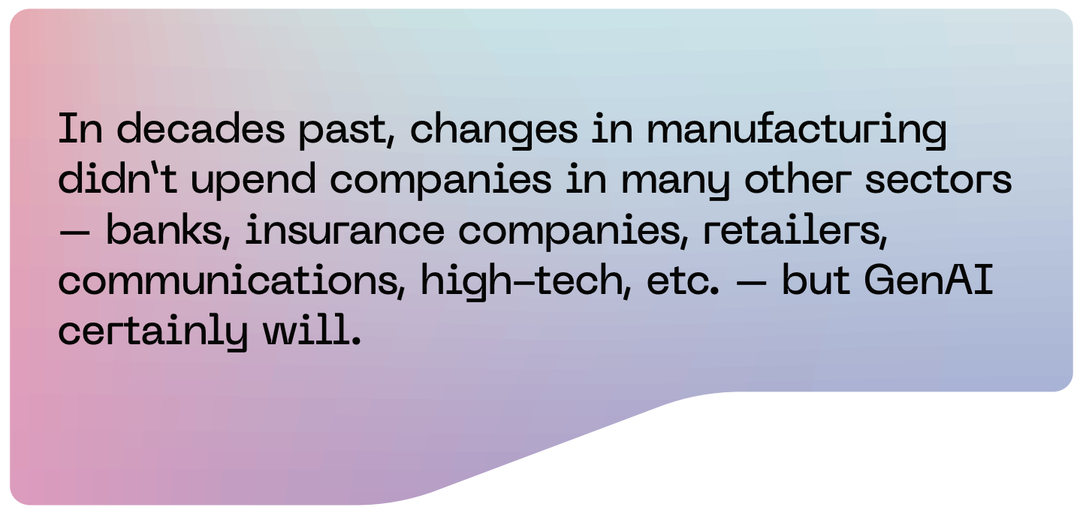
AI </Recodes> “Tier One” Disrupting The Service Provider League Table
AI </Recodes> “Tier One,” https://ascendion.com/wp-content/uploads/2024/08/AI-Recodes-Tier-1.pdf

Slide 20



Client Outcomes
Want to Read More? CLICK HERE
Ascendion modernized a 40-year-old banking platform for a leading online bank, utilizing GenAI-driven solutions, resulting in:
Ascendion transformed a healthcare company's compliance and reporting systems by migrating to Power BI and utilizing Snowflake for cloud storage, resulting in:
Ascendion modernized a specialty retailer's supply chain, by integrating a cloud-based platform, resulting in:
70% improvement in in-store product availability
40% cost savings through cloud transition
$5 million recovered in lost sales by reducing BOPIS order abandonment
For more details, visit the full case study here.
Achieved 45%+ cost savings
Leveraged Ascendion AAVA™ Digital Ascender to reverse-engineer 700,000 lines of code in just 3 weeks
Expected 33% savings in costs and resources over three years
Modularized platform designed for scalability, secure payment processing, and transaction tracking
For more details, visit the full case study here.
80% reduction in manual reporting efforts
50% increase in proactive risk reduction
35% increase in Medicare and Prescription Drug Plan compliance
For more details, visit the full case study here.

